Slide 1
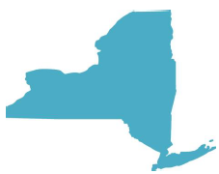
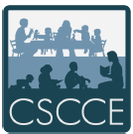
Teaching the Teachers of our Youngest Children: The State of Early Childhood Higher Education in New York, 2015
Center for the Study of Child Care Employment
University of California, Berkeley

Slide 2
A Brief History
National Context – Whitebook, et al as partners
Original plan – Federal Early Learning Challenge Grant
Funding Opportunity
Institute of Medicine Report

Slide 3
Study Design
Participants
Programs
27 associates degree programs
29 bachelor’s degree programs
58 master’s degree programs
Faculty
74 community college faculty members
194 bachelor’s and graduate degree faculty members
Procedure
CSCCE Researchers implemented the Early Childhood Higher Education Inventory
Mapping of population of higher education programs within the state
Online program survey for degree program leaders
Online faculty survey

Slide 4
Response Rate

Slide 5
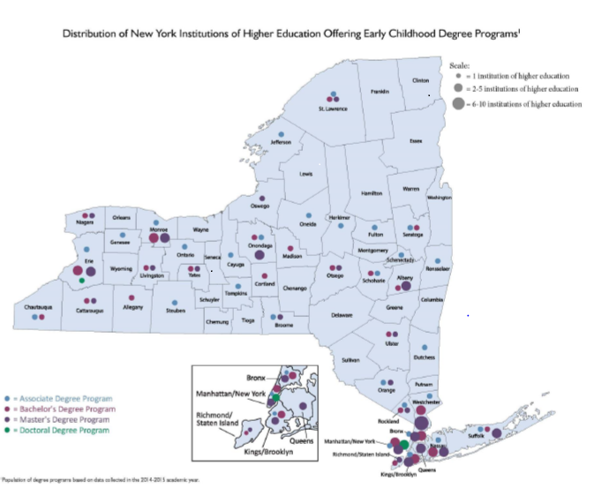
Map of New York’s Programs

Slide 6
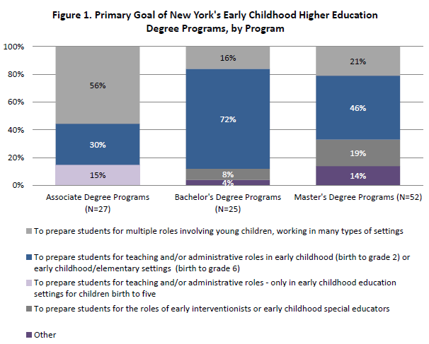
Purpose of Programs

Slide 7
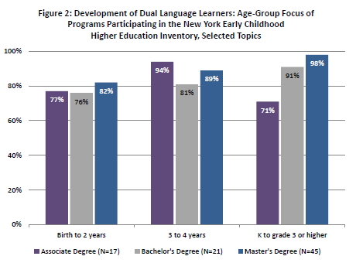
Focus on Dual Language Learners

Slide 8
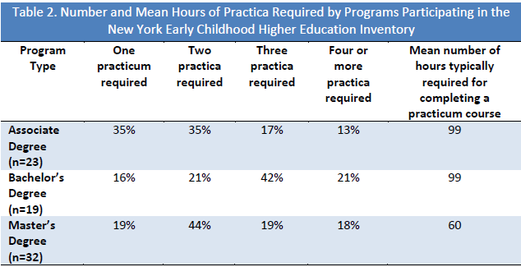
Field Experience

Slide 9
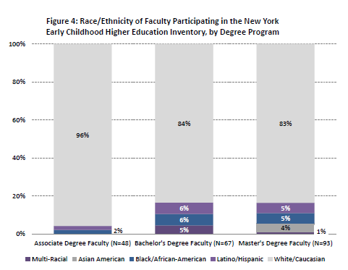
Faculty in NY – Race and Ethnicity

Slide 10
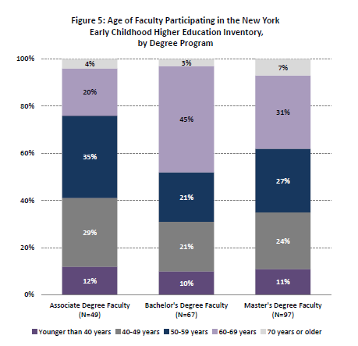
Faculty in NY – Age

Slide 11
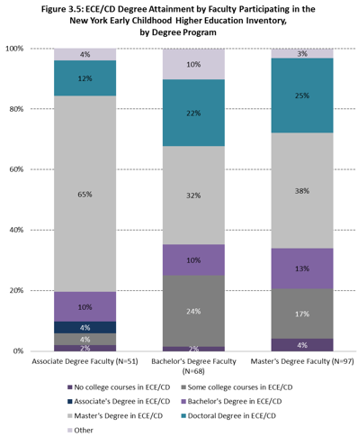
Faculty in NY – Degree Attainment

Slide 12
Student Supports and Challenges
Supports
Challenges
Academic and financial aid counseling
Convenient class locations and times (e.g., evenings, weekends)
Academic tutoring
Assistance with technology
Insufficient ability to recruit students
Faculty administrative responsibilities that interfere with time with students
Need for additional resources for students

Slide 13
Faculty-Related Challenges
Support for Faculty
Faculty Diversity and Expertise
Need for additional resources
Faculty professional development
Staffing
Travel funding
More individual faculty planning time
Racial/ethnic diversity
Linguistic diversity
Expertise in teaching dual language learners
Expertise in teaching infants and toddlers
Expertise in teaching young children with special needs
Expertise in science pedagogy for young children

Slide 14
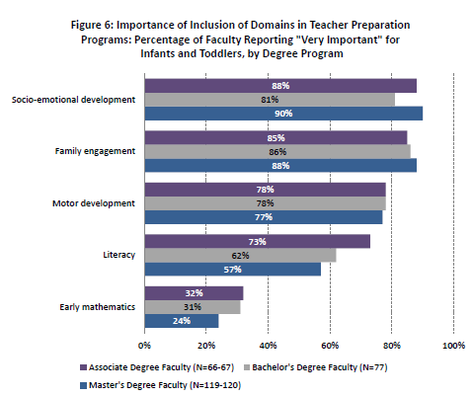
Infant and Toddler Focus

Slide 15
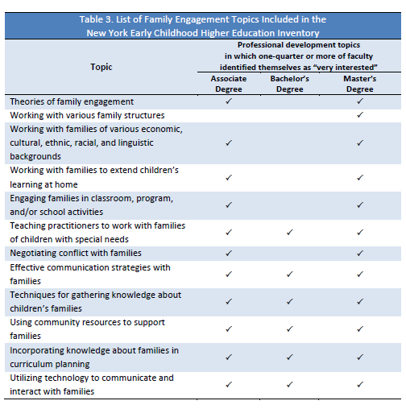
Family Engagement Focus

Slide 16
Recommendations
Unify expectations and pathways for early childhood workforce preparation
Strengthen program content and equity across the age span
Build a leadership pipeline
Prepare an incoming generation of faculty
Increase faculty support

Slide 17
Questions?

